Slide 1
Renewable energy project
Group Members:
202312086 JINSI SHAH
202312106 LAKSHYA JAIN
202312060 KHUSHI TRIVEDI
202312087 ANUJ AWASTHI
202312118 MEGHA MAHESHWARI

Slide 2
INTRODUCTION
In this comprehensive renewable energy project, the database is structured with tables to efficiently manage the intricate processes involved. The relational database includes tables such as “project” to handle the overarching initiative, “site” for multiple sites within each project, “turbine” for managing the selection and installation of turbines, and “grid_connection” to organize the connection of multiple turbines within a grid.
To ensure regulatory compliance, tables like “permit” and “regulatory_standards” are incorporated, providing a systematic approach to obtaining necessary permissions and meeting regulatory requirements at each site. The installation process is managed through the “installation_team” table, overseeing the erection of turbines with precision.
The environmental impact of every project is meticulously recorded in the “environmental_impact” table, emphasizing the commitment to understanding and mitigating the ecological footprint. This structured database not only facilitates efficient project management but also aligns with Green Energy Corporation’s commitment to sustainability, compliance, and a systematic approach to installation throughout the renewable energy initiative.

Slide 3
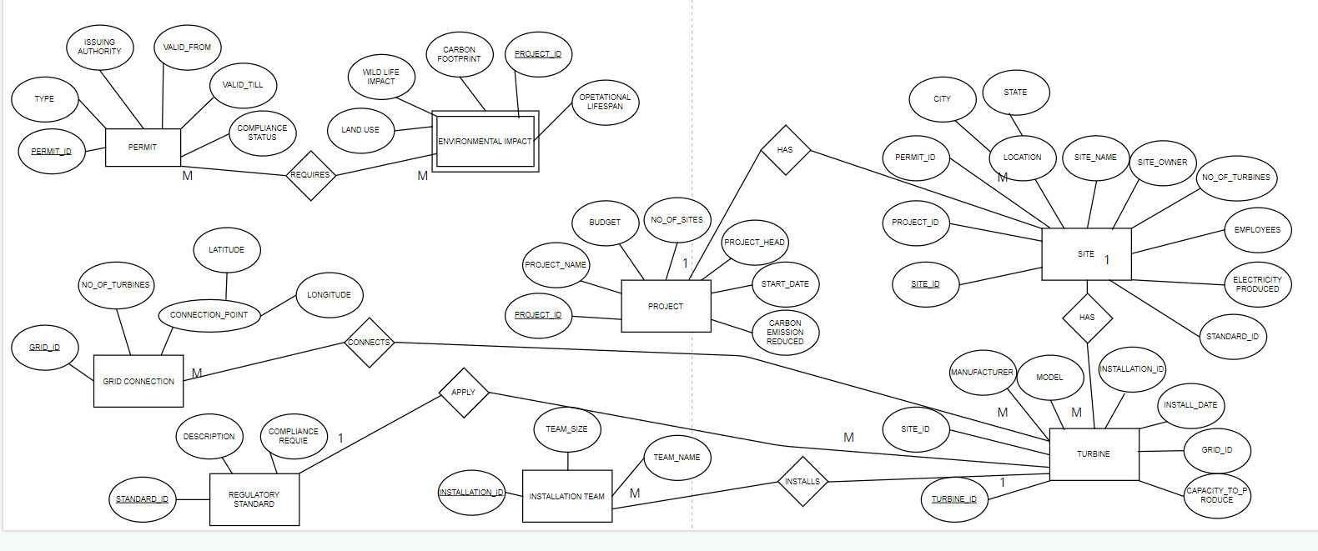
ENTITY RELATIONSHIP diagram

Slide 4
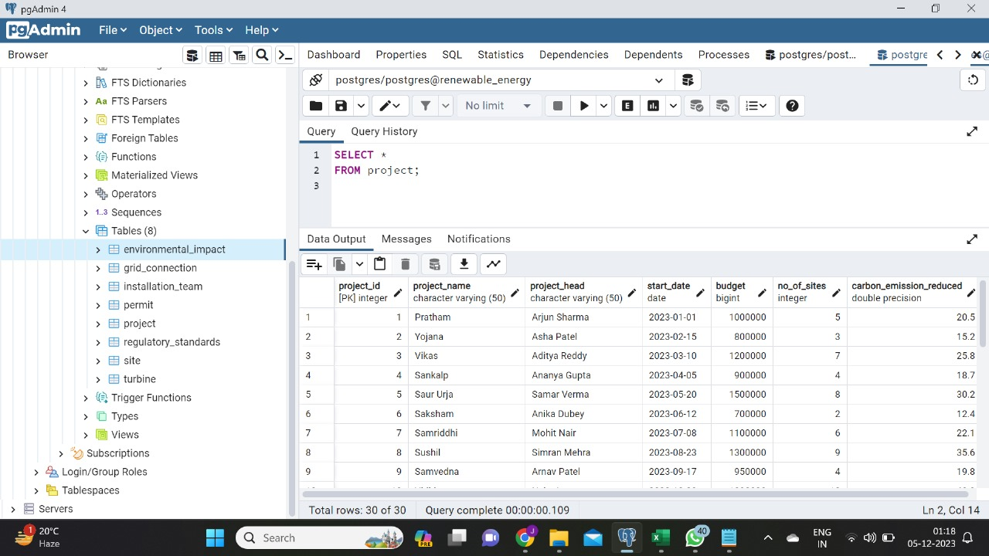
SQL TABLES

Slide 5
SQL QUERIES
Simple queries:
write a SQL query which gives the environmental impact details of all the projects.
SELECT * FROM environmental_impact;
write a SQL query which gives the details of grid_connection where no of turbines is 4.
SELECT * FROM grid_connection WHERE no_of_turbines = 4;
write a SQL query which gives the details of permit where permit type starts from ’p’.
SELECT * FROM permit WHERE permit_type LIKE 'p%’;
write a SQL query which updates project_name to ‘Milap’ where project_id is 20.
UPDATE project SET project_name = 'Milaap’ WHERE project_id = 20;
write a SQL query which gives details of all projects ordered by budget.
SELECT * FROM project ORDER BY budget;

Slide 6
SQL QUERIES
Complex queries:
write a SQL query which gives the project details of those project which has any site.
SELECT project_name, project_head, budget FROM project join site ON site.project_id = project.project_id;
write a SQL query which gives the total number of turbines installed for each site.
SELECT s.site_id, s.site_name, ( SELECT COUNT(*) FROM turbine t WHERE t.site_id = s.site_id ) AS total_turbines FROM site s;
create a view which gives me site details which has permit of ‘Construction‘.
CREATE VIEW site_permit AS SELECT site.site_name, site.site_owner, site.electricity_produced FROM site, permit WHERE site.permit_id = permit.permit_id AND permit.permit_type = ‘Construction’;
write a SQL query which gives project details which has maximum budget.
SELECT * FROM project WHERE budget = (SELECT MAX(budget) FROM project);
write a SQL query to find total carbon emission of every project
SELECT project_id, SUM(carbon_emission_reduced) AS carbon reduced FROM site GROUP BY project_id;

Slide 7
RELATIONAL QUERIES
Simple queries:
write a SQL query which gives the environmental impact details of all the projects.
π(land_use, wildlife_impact, carbon_footprint, operational_lifespan, project_id)(environmental_impact)
write a SQL query which gives the details of grid_connection where no of turbines is 4.
π (grid_id, longitude, latitude, no_of_turbines)(σ(no_of_turbines = 4)(grid_connection))
write a SQL query which gives the details of permit where permit type starts from ’p’.
π (permit_id,permit_type,issuing_authority,valid_from,valid_till,compliance_status)(σ(permit_type LIKE 'p%')(permit))
There is no direct relational algebra notation for updates. Updates are typically expressed in SQL.
write a SQL query which gives details of all the projects order by budget.
π(project_id, project_head, start_date, budget , no_of_sites, carbon_emission_reduced)(σ(true)(project X project))

Slide 8
RELATIONAL QUERIES
Complex queries:
write a SQL query which gives the project details of those project which has any site.
π(project_name, project_head, budget) (σ(project.project_id = site.project_id) (project X site))
write a SQL query which gives the total number of turbines installed for each site.
π (site_id, site_name, Gcount(turbine_id) ((σ (R1.site_id = R2.site_id) (R1 ⨝ R2))
create a view which gives me site details which has permit of ‘Construction‘.
π(site.site_name, site.site_owner, site.electricity_produced ) (σ(site.permit_id = permit.permit_id ^ permit.permit_type = ‘Construction’) (project X permit))
write a SQL query which gives project details which has maximum budget.
π (project_id, project_name, project_head, start_date, budget, no_of_sites)((σ budget = Gmax(budget) (project)))
write a sql query to find total carbon emission of every project
π (project_id, Gsum(carbon_emission_reduced) AS carbon_reduced ((site) γ project_id {project_id, Gsum(carbon_emission_reduced)})

Slide 9
CONTRIBUTION
Entity Relationship Diagram : Khushi Trivedi
Database creation and data insertion: Jinsi and Megha
Sql queries:
Simple: Lakshya and Anuj
Complex: Khushi and Anuj
Relational queries: Jinsi and Megha

